Slide 1


LOYALTY TO THE BANK VS CREDIT SCORES
BY: HILARIOUS EDEM ANKU

Slide 2



INTRODUCTION
Banks love credit scores!
Banks, like any other business, love to retain customers. Banks want loyal customers too.
In view of this, what should banks look out for if they want loyal customers?
Is a high credit score an indicator of loyalty to the bank?

Slide 3

THE HYPOTHESIS
The hypotheses tested in this study are:
Null Hypothesis: Loyal and non-loyal customers have on average the same credit scores
This in other words means that there is no difference in the average credit scores of loyal and non-loyal customers.
Alternative hypothesis: Loyal and non-loyal customers have significantly different average credit scores.

Slide 4
THE DATA
Data for this study comes from Kaggle
The dataset contains 10,000 observations and 14 variables. There are no missing values in this dataset.
It must be noted also that the data was collected in Europe, hence, the behaviors exhibited by these consumers may be geography specific.
However, the insight gleaned from this study may well be applicable in the American context.
More so, we can easily repeat this study if similar data can be obtained. We can also implement further statistical studies to ascertain location specific behaviors.

Slide 5
METHODS
The data was taken through the following procedures to arrive at conclusions
The data was split up into two major groups:
Customers who left the bank
Customers who didn’t leave the bank
The distributions were checked for normality through visualizations and statistical tests.
A 95% interval for the difference in means was then estimated.
A t-test was then implemented to compare the groups.

Slide 6
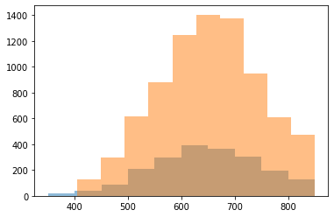
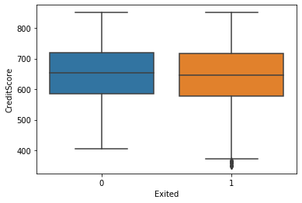
RESULTS
The histogram plot reveals that the distributions are approximately normally distributed
The box plot also confirms that there aren’t outliers that should be of concern.

Slide 7

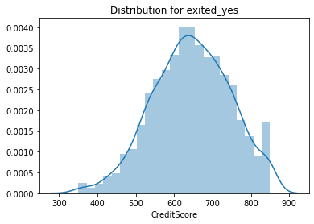
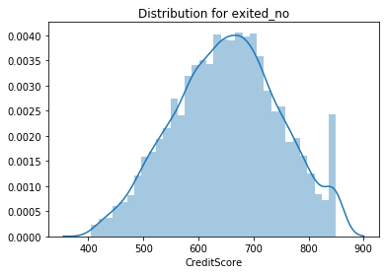
RESULTS
The two distributions plotted separately also shows that they are quite normally distributed.

Slide 8
RESULTS
For the distribution of customers who left:
Skewness = 1.1409
Kurtosis = 0.2763
For the distribution of customers who didn’t leave:
Skewness = 0.0470
Kurtosis = 0.4851
Formal statistical tests to check normality shows that both groups are approximately normally distributed.

Slide 9
RESULTS
T-statistic = 2.71 > 1.96
P-value = 0.0067 < 0.05
Based on these results, the null hypothesis is rejected.
I conclude that the two groups are significantly different from each other in terms of their credit scores.
The implications and insights from this conclusion are discussed in the next slide
The 95% confidence interval of the difference in means is estimated between 1.7 and 11.3.

Slide 10
DISCUSSION AND RECOMMENDATIONS
From my conclusion, the fact that the two groups of customers are significantly different from each other is established.
This conclusion implies that high or low credit score is a good indicator of which customers will be loyal to the bank.
If the bank is interested in retaining customers, credit scores must be factored into customer retention programs.
Credit scores are important indicators to customer loyalty; however, other factors may also affect this. Further research is required to identify other factors.

